Slide 1

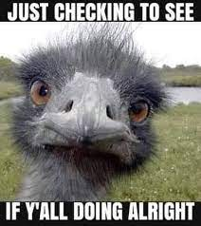
LEADING Boot camp
Monday, June 14, 2024
From whatever time Alex Poole finishes to 12:15 PM ET
Agenda:
How’s everyone doing
Big metadata (brief comments)
Ontology/briefly linked data
~ Protégé
4. Other/open discussion (time permitting)
?

Slide 2
What is Metadata?
Metadata is a first-class data object
Representation of a thing, event, activity…
Assertions, statements (property/value)
Data about data, info. about information… blah blah blah
Data that makes other data/information objects useful (Musik, 1997)
Data supporting one or more function/action (discovery, rights/access, authenticity, preservation, linking, provenance tracking, validation…) (Greenberg, 2003, 2010, etc.)

Slide 3
Components of Metadata Standards
Data structure Standards (container, label, semantics) | Data communication standards (encoding, markup, data exchange) | Data value standards (authority files, ontologies, taxonomies, etc.)
Data syntax standards | Data syntax standards
element/property ordering | think grammar… | content syntax
Metadata models

Slide 4
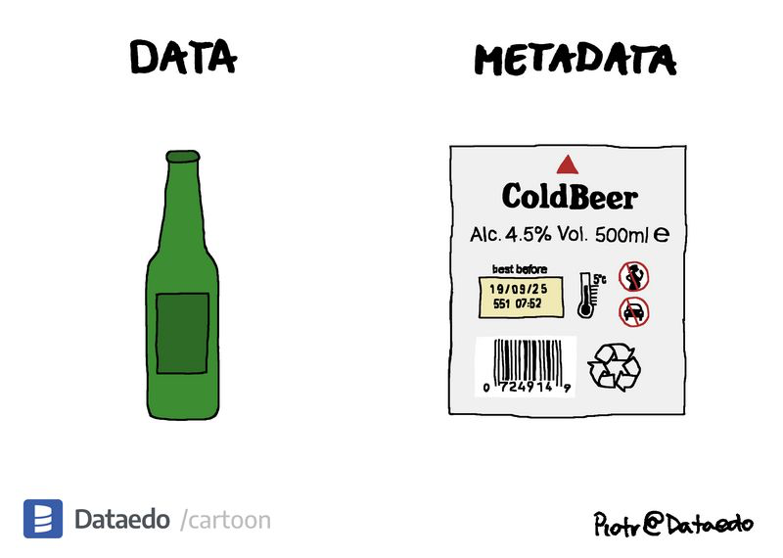

Slide 5

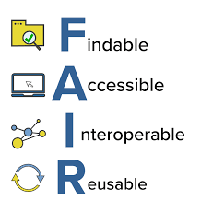
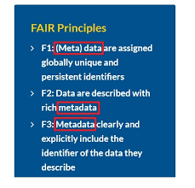
FAIR Data Principles
Wilkerson, et al, (2016) The FAIR Guiding Principles for scientific data ...

Slide 6
Big Metadata
Where there’s big data, there’s often metadata, or metadata is needed
ChatGPT
“Overall, while "big metadata" is not a standard industry term, it can be understood as the management and analysis of metadata on a large scale in the context of big data.”
“…. the context of big data, metadata plays a crucial role in dealing with the massive volume, velocity, and variety of data.”

Slide 7
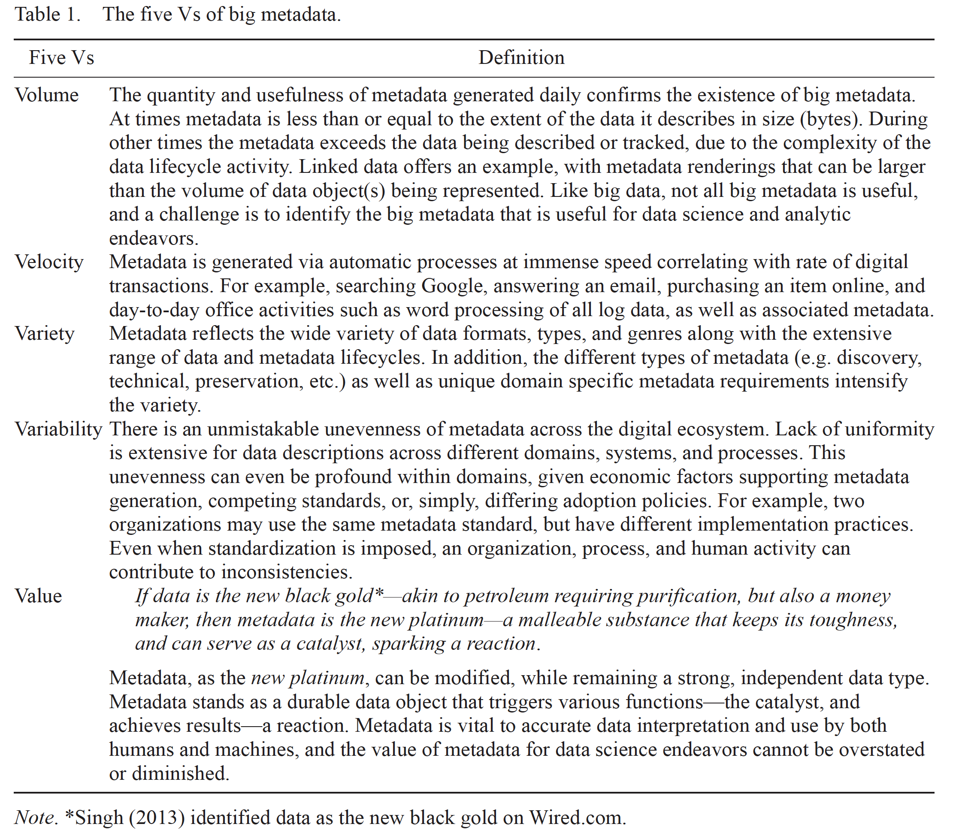
Big Metadata
Greenberg, J. (2017): doi.org/10.1515/jdis-2017-0012

Slide 8
Not everyone like metadata, but it’s integral to data science work and more…

Slide 9
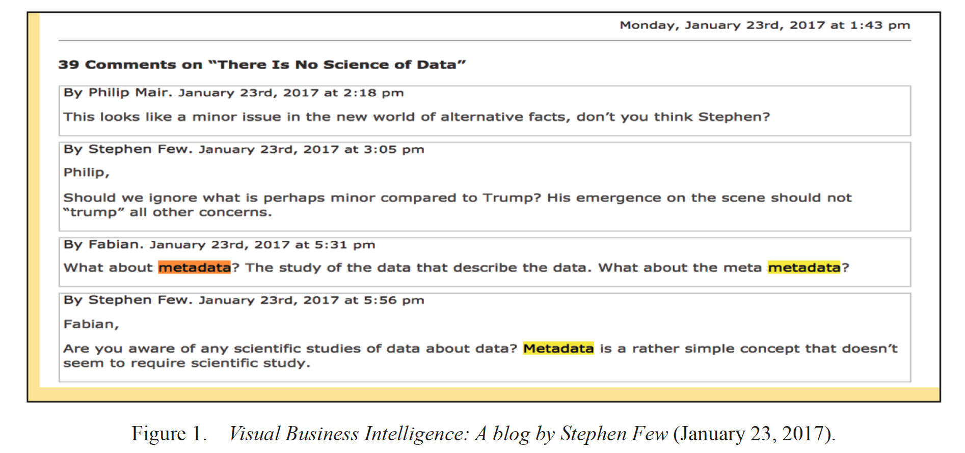
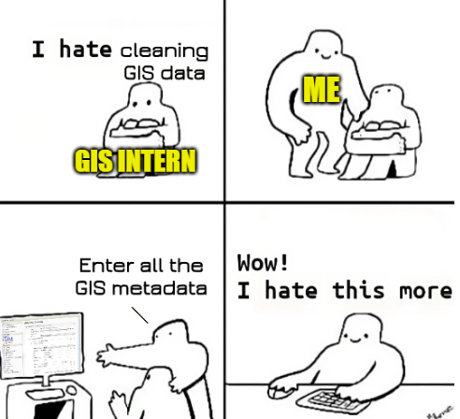
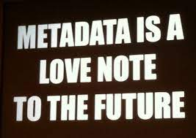
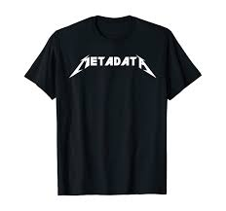
Metadata has a bad reputation

Slide 10
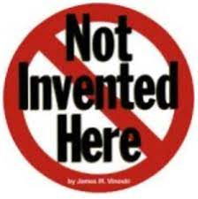
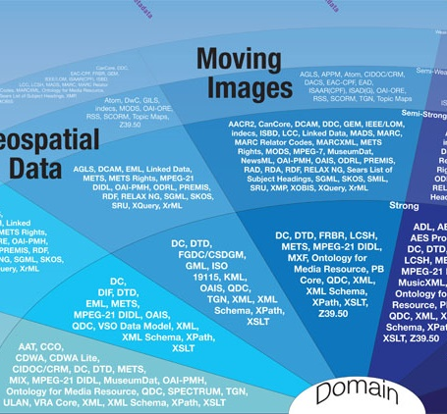

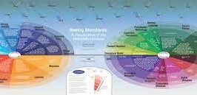
Metadata ecosystem (complex)
Types of representation standards
Data structure standards
The semantics, container
Data communication standards (the wrapper)
Encoding (e.g., JSON, XML, etc.)
Data syntax standards
Cuts across other standards (element ordering, content syntax, and encoding syntax)
Data value standards
Ontologies, thesauri, authority files, etc., KOS (Knowledge Organization Systems)
Models

Slide 11
Research Data Alliance Conference
Peter Fox, RDA, Sweden, 2014
Let’s get rid of the word metadata

Slide 12
Metadata challenges contributing to uncertainty/ impacting data science, AI,…etc.
Metadata: It’s complicated, it’s not always perfect….
Data challenges | System challenges |  | People challenges
Massive amounts + wide variety (big metadata), Metadata deserts Ambiguity, not clearly labeled Synonymy, polysemy Noisy data (errors, unstructured) Lacking standards, context, misinterpreted | One and done ~ sort of (after fine tunning, on to the next project) (impact ROI)
Not just data – software, algorithms, research methods, modeling details |  | Biases/subjectivity Time constraints Funding limitations | Biases and subjectivity Time constraints Funding limitations

Slide 13
Accelerating approaches - addressing metadata challenges
Toward metadata best practices supporting workflows, RCR (reproducible computational research) and the FAIR principles
Celebrate, build on, and adapt successes (clear demonstrations)
Explore hosting an embedded/feral metadata expert, software engineer/data scientist (cross-training)
Establish metadata-related metrics (validation, uncertainty?)
~ Informetric values/entropy
Adopt or modify metadata workflows
Agree on semantics
Recognize there is a science of metadata, valid research topic

Slide 14
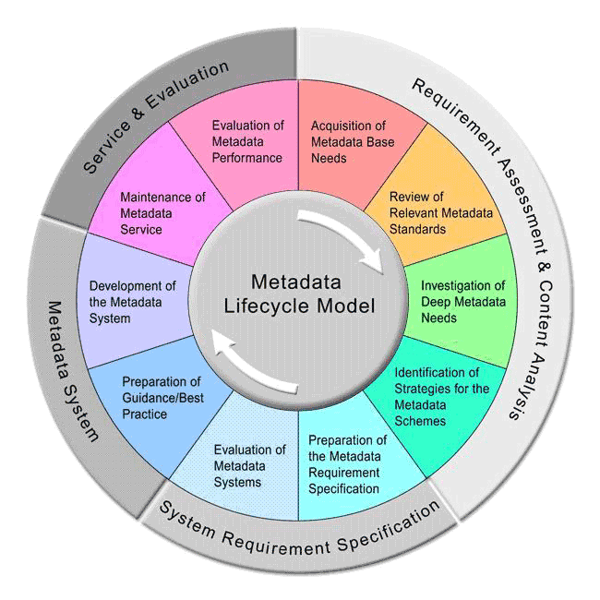
Establish metadata-related metrics (validation, uncertainty?)
(Bruce& Hillmann, 2004 to Razzaghi, et al, 2023 )
Informetric value/Claude Shannon (entropy)
Confidence intervals (AMeGA + HDR-BGNN) (Greenberg, et al, 2021-2023)
Metadata maturity model (RDA)
Adopt, or modify metadata workflows (w,w,w,h,w?)
Metadata Architecture and Application Team (MAAT) “Metadata Lifecycle Model” for systematizing the metadata working procedure.
https://metadata.teldap.tw/design/lifecycle_eng.htm
Completeness
Provenance
Accuracy
Conformance to expectations
Logical consistency/coherence
Timeliness
Accessibility

Slide 15
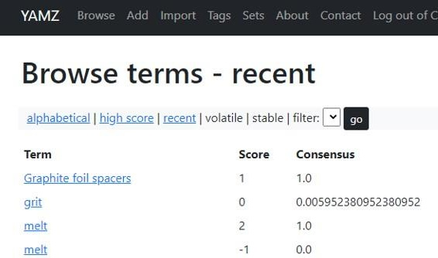

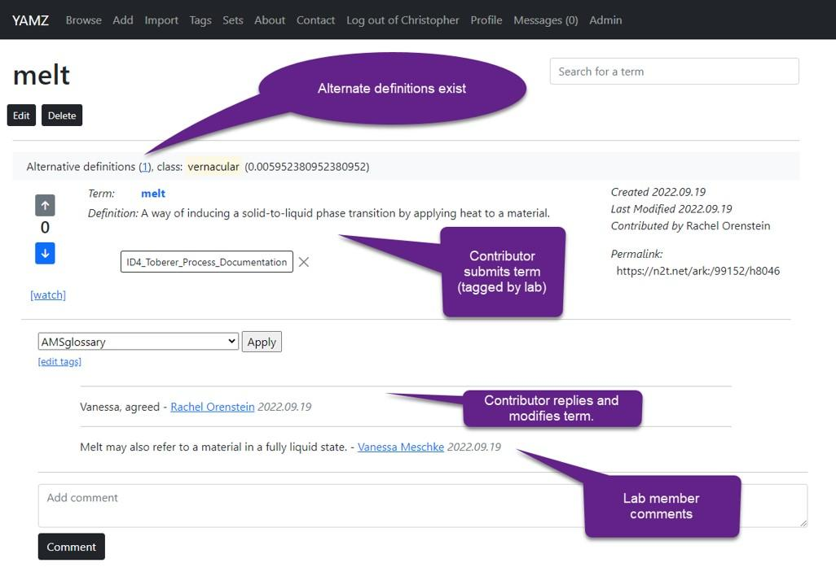
Agree on semantics 👍 👍🏾 👎🏼
Yet Another Metadata Zoo
METADICTIONARY
A crowdsourced vocabulary builder
Add terms and get permalinks (PIDs)
Use and link controlled terms
Share and refine project terms
Cherry-pick terms for ontologies
Dialog, test, and vote to consensus quickly
https://doi.org/10.1162/dint_a_00211

Slide 16
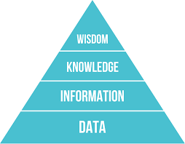
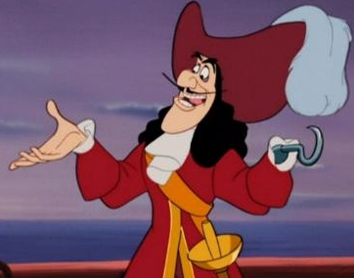
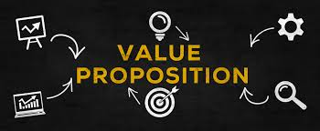
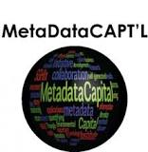
DIKW pyramid
https://en.wikipedia.org/wiki/DIKW_pyramid
Recognize there is a science of metadata; metadata is a valid research topic
Toward optimal metadata…

Slide 17
Ontology

Slide 18

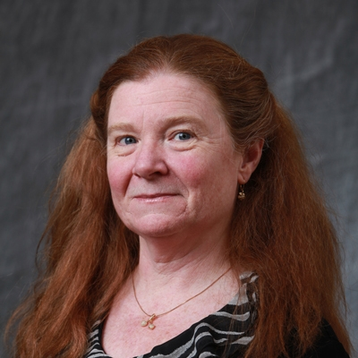
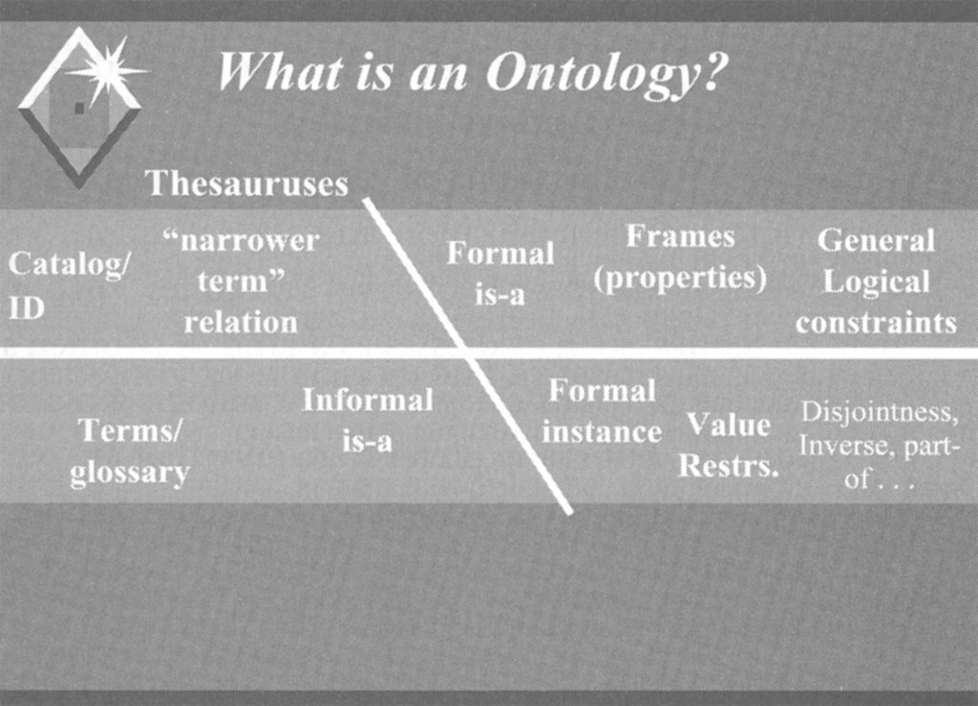
(McGuinness, D. L. (2003). Ontologies Come of Age. In Fensel, et al, Spinning the Semantic Web. (Cambridge, MIT Press)
Ontology

Slide 19
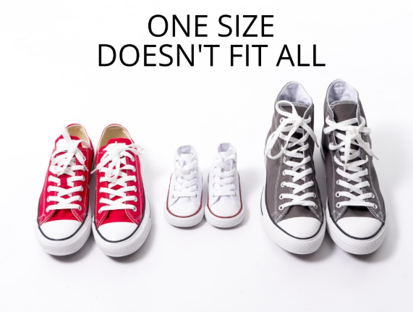

Ontologies and reality

Slide 20
Zeng, Marcia Lei. 2008. “Knowledge Organization Systems”. Knowledge Organization 35, nos. 2-3: 160-82.

Slide 21
Philosophy
Dates back to 5th Century B.C. when Empedocles divided the world into four elements – earth, fire, water and air.
Aristotle ∙ classification
Touches on “epistemology,” which” is about knowledge and knowing
Metaphysics: Defined by philosophers as the nature of being or existence.

Slide 22

Ontology defined
Other important
stuff
(comfy space)
No exact definition
Generally speaking - ontology is a WAY to convey a theory on how to represent a class of things and their relationships
Knowledge representation, Knowledge organization (ILS)
Blurry lines – w/database structure and knowledge graphs
Webster’s dictionary
A science or study of being specifically, a branch of metaphysics relating to the nature and relations of being.
A theory concerning the kinds of entities and specifically the kinds of abstract entities that are to be admitted to a language system.
Thomas Gruber
“An ontology is a specification of a conceptualization”
A must read!

Slide 23
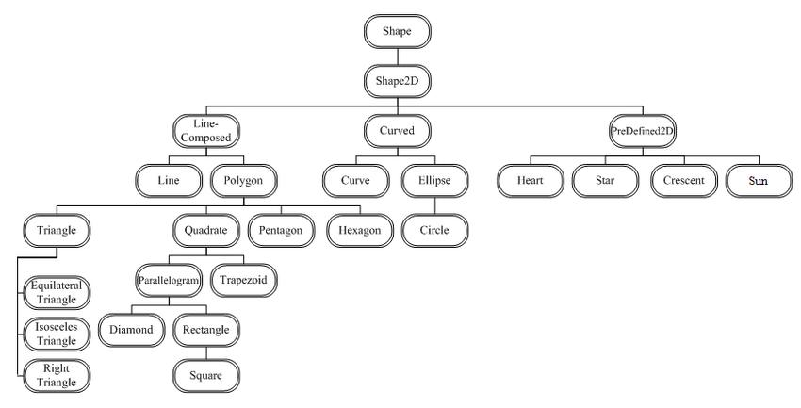
AN ONTOLOGY OF SHAPES
http://ceur-ws.org/Vol-812/paper9.pdf

Slide 24
Ontology
National Center for Biological Ontologies: https://bioportal.bioontology.org/
Example of a
Film ontology→

Slide 25
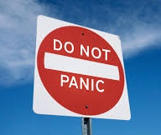
Most ontologies structured as taxonomies, hierarchies
People talk about ontologies in many, many, many… ways
Basic ontology has two classes of elements: the entities and the relationships between them
Class and sub-classes: Actor, Child actor
Relationships
Is a type of
Movie “is directed by” director
Movie “has performance” actor
This is more involved than a lexical-semantic thesaurus.
More involved / RDF triples
Predicate (has a property of X)
E.g., Book has title
predicates are linguistic entities
Subject-predicate-object (think reverse ABC)
Organized according to axioms or rules that control how the world will be defined.

Slide 26
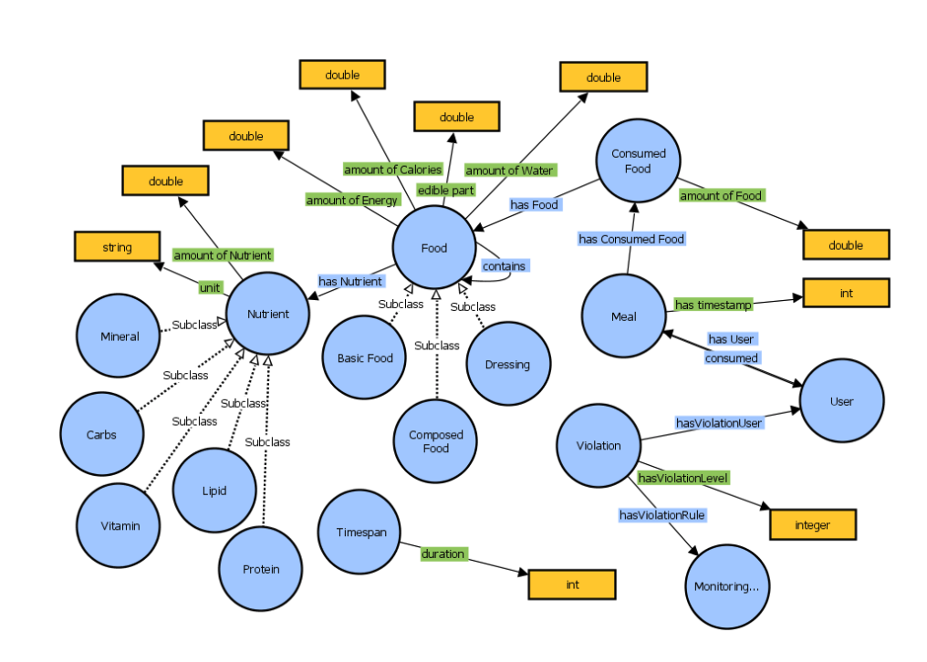
AN ONTOLOGY OF FOOD
https://www.w3.org/community/owled/files/2016/11/OWLED-ORE-2016_paper_3.pdf

Slide 27

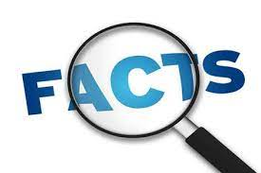
Important Facts
What exists is only what is represented in the ontology
Most ontologies focus on a specific area to conceptualize the world.
Must be updated to keep up with dynamic world
No set discipline or methodology!
Joined together with instances, get closer toward knowledge graph... but fuzzy line

Slide 28
The Role of Ontology
Indexing, browsing, finding, visualizing…
Application areas
Indexing
Knowledge Sharing & Reuse
Artificial Intelligence (AI)
Enterprise Modeling
Software Design
Molecular Biology
eCommerce
Semantic Web….
A language, reliable sharing of information
Enable reuse of domain knowledge
Makes assumptions more explicit
Analyze domain knowledge
Reasoning

Slide 29
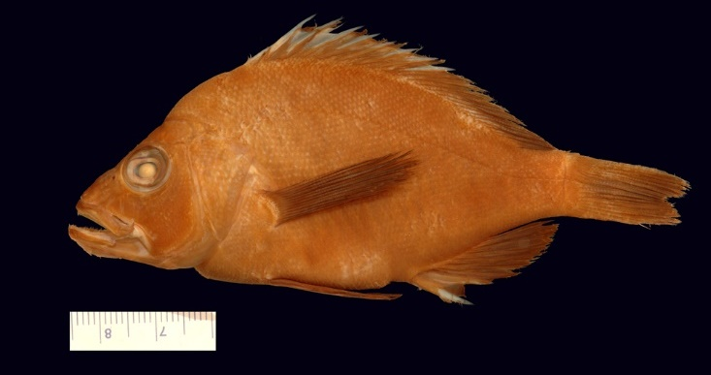
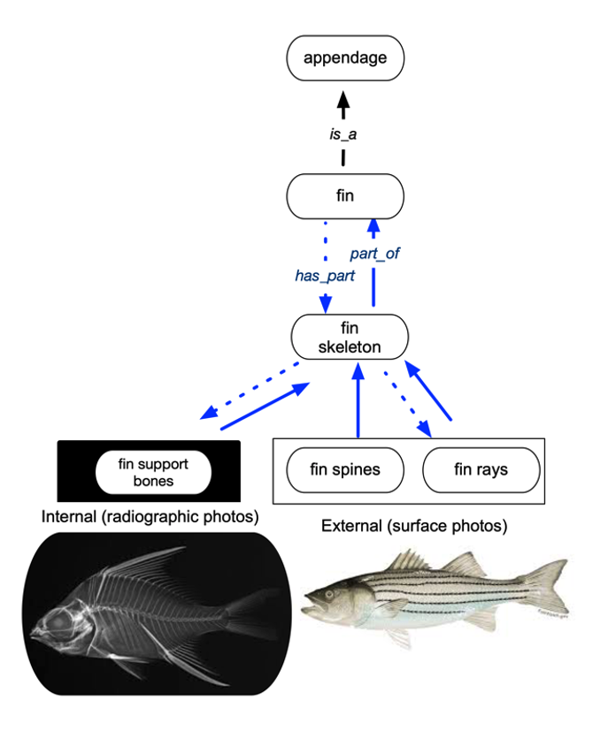
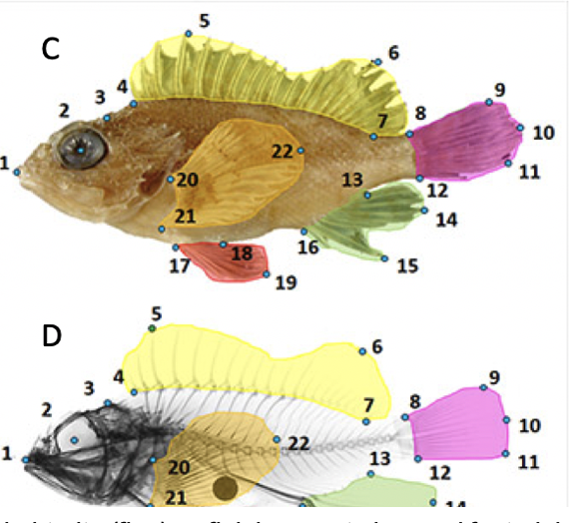
Reasoning to identify species variation
NSF-HDR Biology Guided Neural Networks (BGNN)

Slide 30
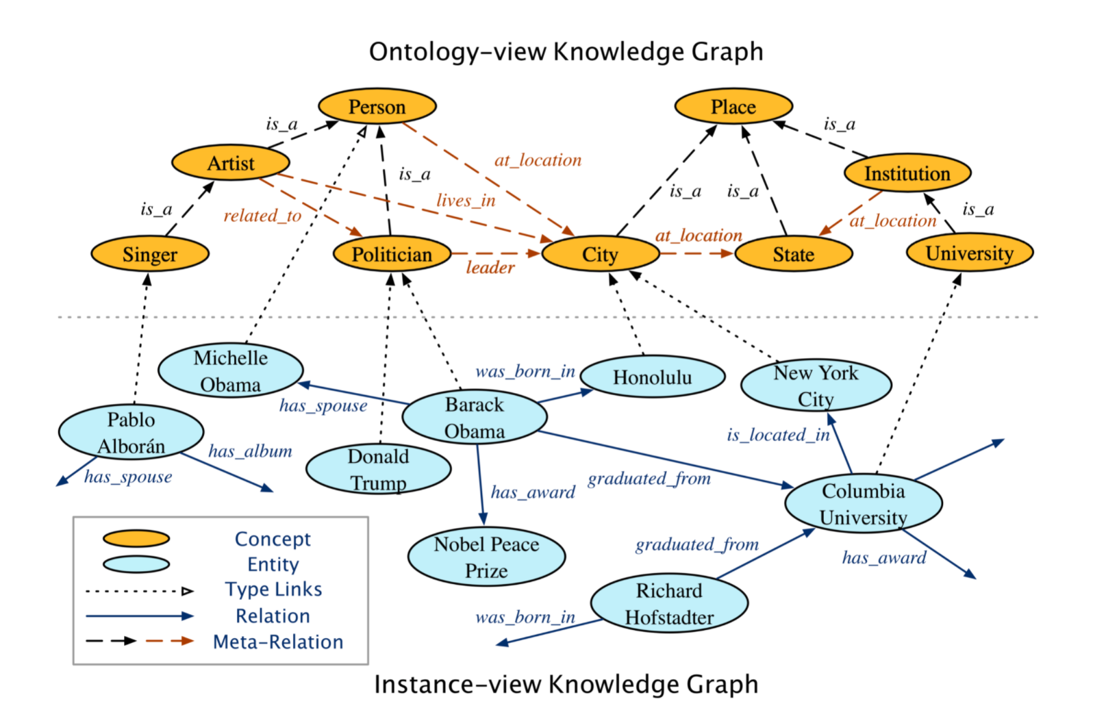

https://www.haojunheng.com/project/joie-kdd/

Slide 31

Linked data
Strings and things
Semantic Web vision
Everything should have a unique ID, in fact a Persistent ID (PID)

Slide 32
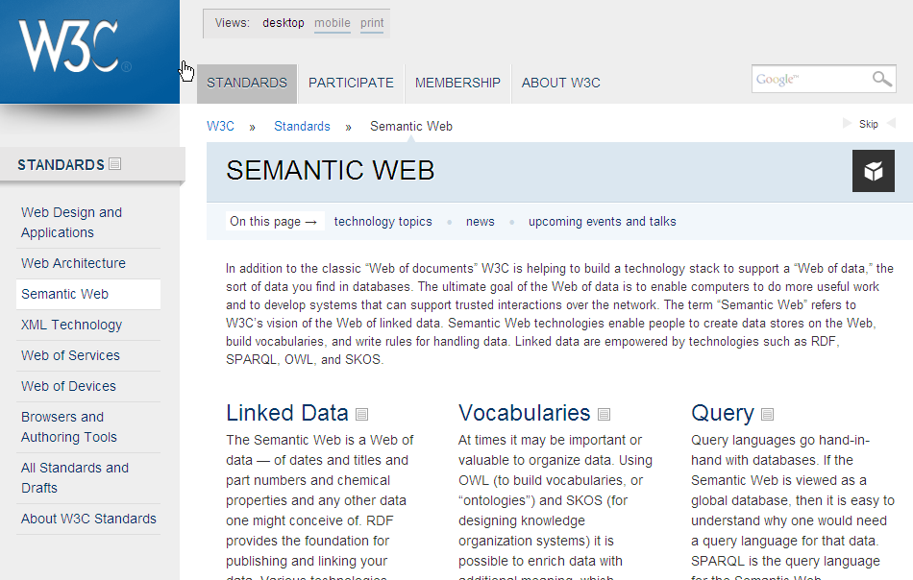
Evolution of the Web http://www.w3.org

Slide 33
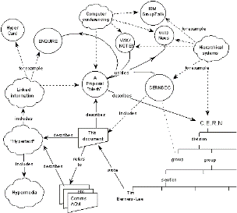
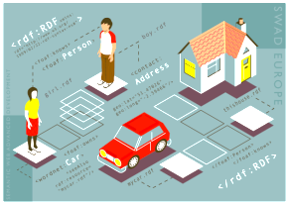
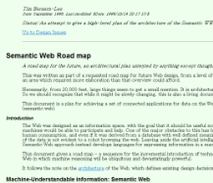

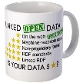
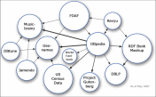



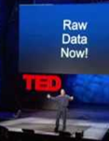
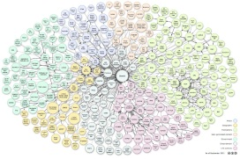
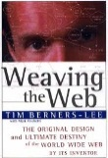









(E. Mendez, 2012)
March, 1989
Activity starts, 2001
Tim BL
LOD principles
FOAF
(Early 2000)
1st LOD Cloud
Cyganiak & Jentzsch (May2007)
Tim BL Roadmap on Semantic Web
(Sept1998)
FOAF Voc. Spec
(May2005)
Berners Lee, Hendler & Lassila (May2001)
Tim BL
Linked Data
(July2006)
OIL
DCMI Singapore
Framework
(Aug2007)
Tim BL TED Talks
(Feb 2009 &
Mar 2010)
Last LOD Cloud
Cyganiak & Jentzsch (Nov2011)
DAML
DCMES
(ISO-2003)
1998
2002
2006
2010
1996
2000
2004
2008
2012
PICS W3C-REC–Oct96
RDFS (RDF Schema)
1st Draft –1998
RDFS (RDF Schema)
W3C-CR, March1998
RDFS Vocabulary
Description Language
SKOS 1st Draft
(May2005)
W3C-REC Aug2009
Library Linked Data XG (May 2010)
Final Reports (Oct2011)
RDF Model & Syntax 1st Draft–Oct97
RDF M&S
W3C-REC, Feb2004
RDF M&S
W3C-REC, Oct99
W3C-REC, Jan2008
MCF Meta Content
Framework–Jun97
W3C Linked Data Platform LDP XG
(May2012)
OWL specifications
W3C-REC, Feb2004
OWL2 specifications
W3C-REC, Oct2009
In XHTML
W3C-REC, Oct2008

Slide 34
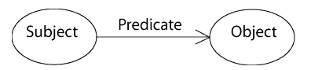
Linked Data based on RDF data model
Is similar to Entity-Relationship or Class diagrams, statements about resource in subject-predicate object expressions called “triples”.
subject= resource
predicate=traits or aspects of the resource and expresses a relationship between the subject and the object.
http://www.w3.org/TR/rdf-concepts/

Slide 35
The sky has the color blue
RDF triple:
A subject denoting “the sky”
A predicate denoting “has the color”
An object denoting “blue”

Slide 36
Example of RDF
<rdf:RDF xmlns:rdf="http://www.w3.org/1999/02/22-rdf-syntax-ns#"
xmlns:dc="http://purl.org/dc/elements/1.1/">
<rdf:Description rdf:about=”https://www.sciencemag.org/news/2020/07/during-pandemic-students-do-field-and-lab-work-without-leaving-home”>
<dc:title>During the pandemic, students do field...
</dc:title>
</rdf:Description>
</rdf>
https://www.sciencemag.org/news/2020/07/during-pandemic-students-do-field-and-lab-work-without-leaving-home
 | subject
 | predicate
 | object

Slide 37
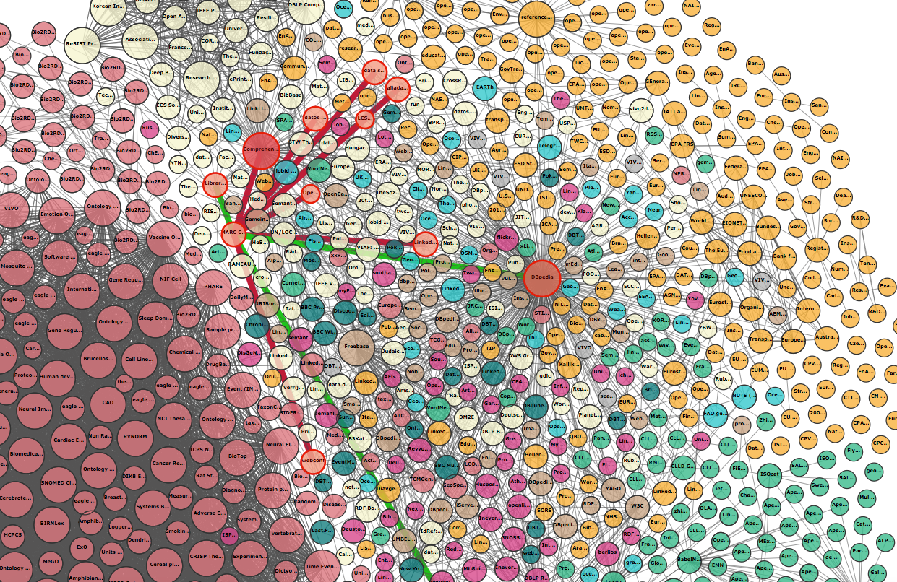
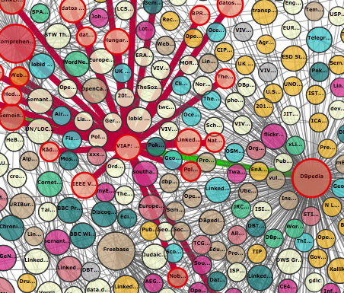
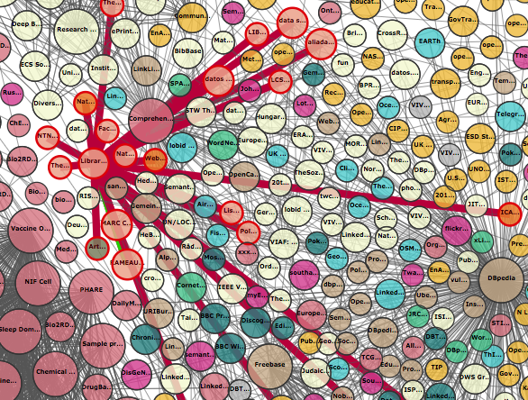
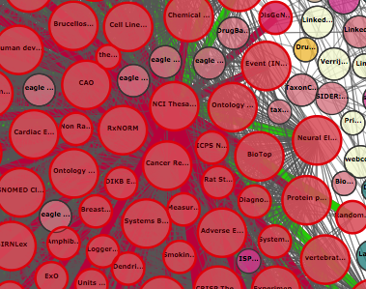
https://lod-cloud.net/

Slide 38
LCSH

Slide 39
Ontologies as “structured terminologies”
Relationships
Is at type of
Causes
Synonyms
An island “is a type of” land area
A nation “is a type of” geopolitical area
I am an ontologist
Dagobert Soergel, ACM/CL, 1997
http://nkos.slis.kent.edu/busch/summary.pdf

